Slide 1
Who Uses Python
Machine Learning
data science, web development, system administration,
industry, healthcare, finance, consulting…etc..

Slide 2


Business Analytics Using Python
Business Intelligence(BI)
Python Data Visualization Libraries

Slide 3
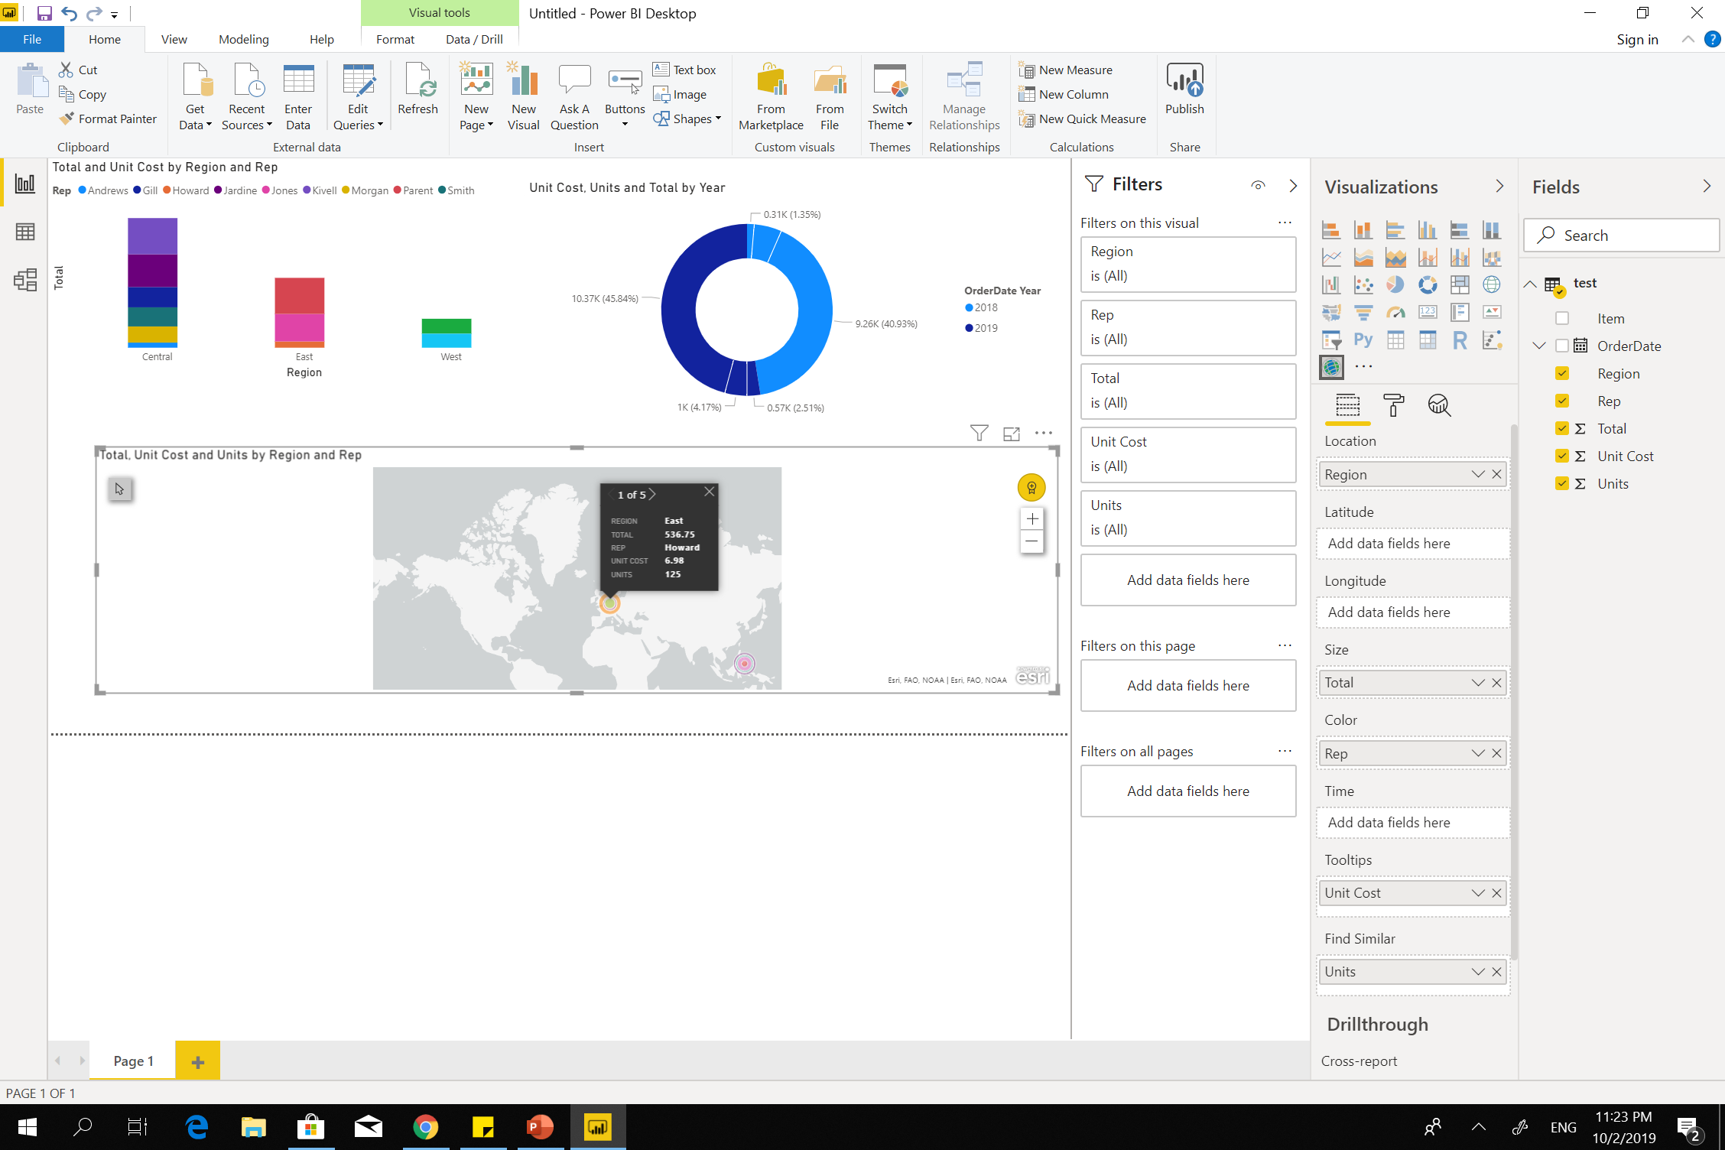
Business Intelligence(BI)
Microsoft Power BI
Tableau
Penthaho
SAP Business Intelligence
MicroStrategy
Sisense…etc…

Slide 4
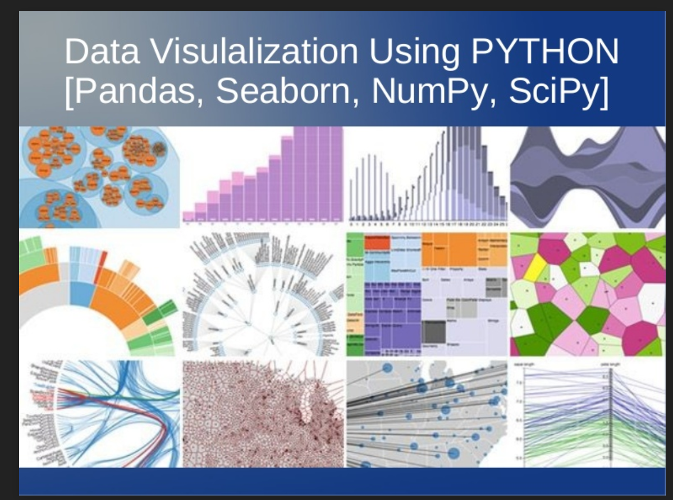
Python Data Visualization Libraries
Matplotlib
Seaborn
ggplot
Pandas
Plotly
Bokeh
Pygal…etc…

Slide 5
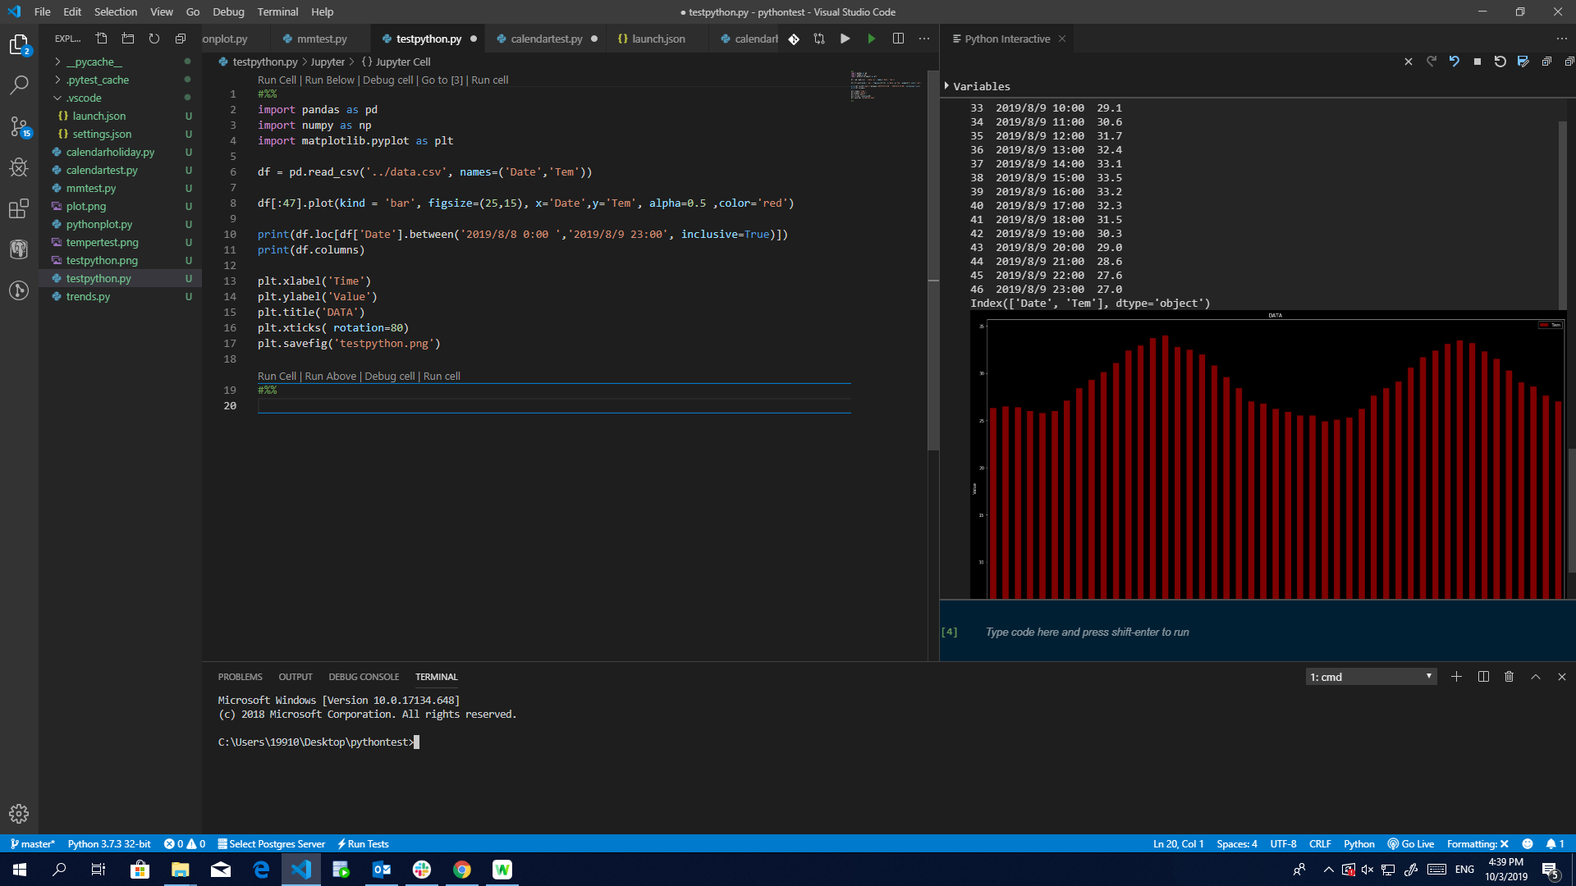
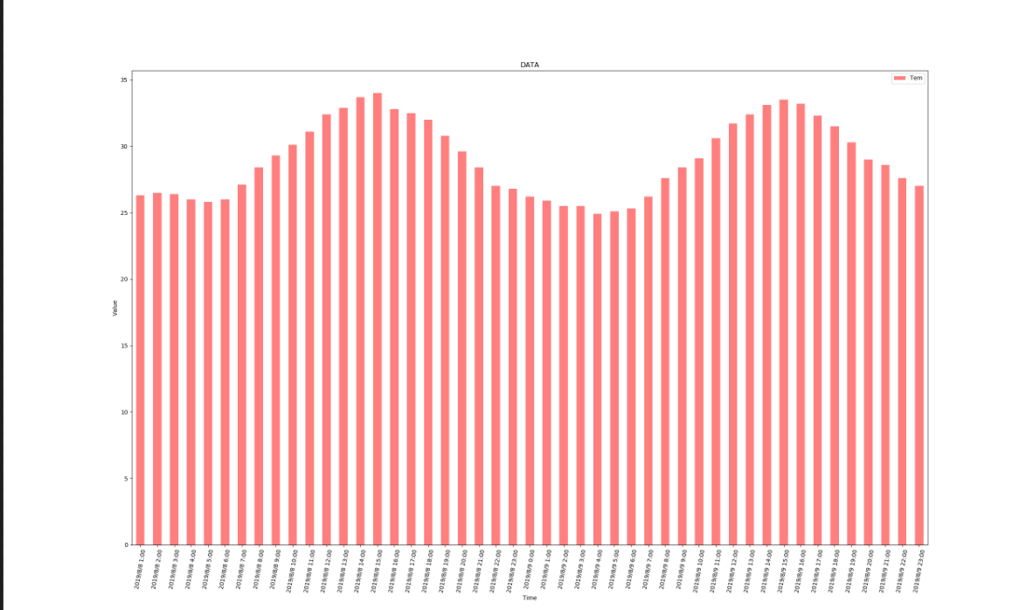
Load Data from CSV Files
df=pd.read_csv(‘../data.csv’,name=(‘Date’,’Temperature’))

Slide 6
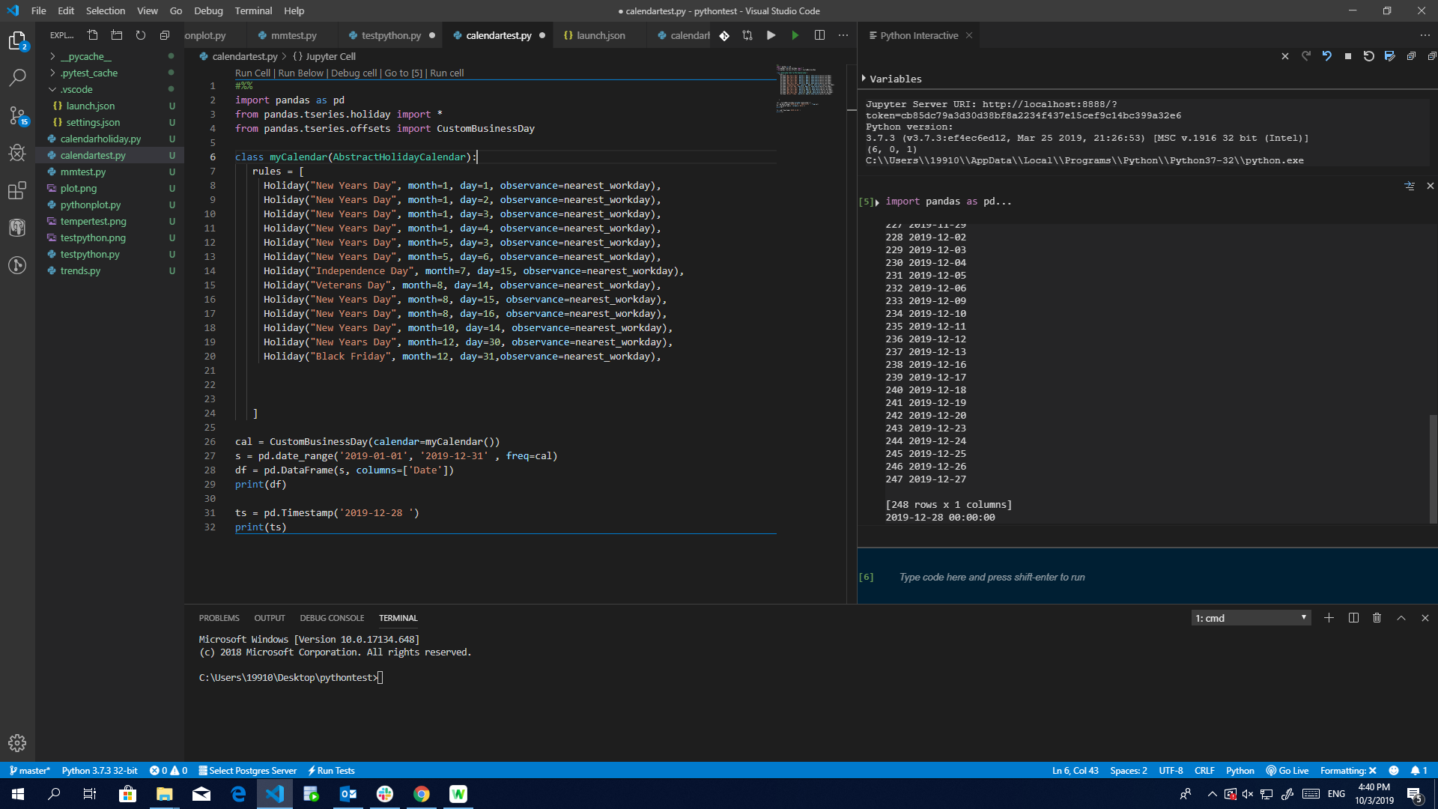
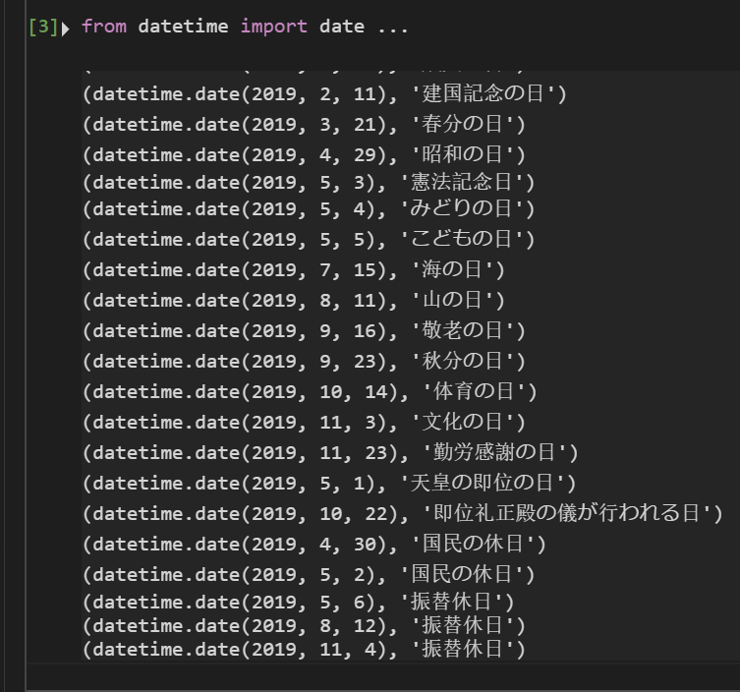
Holiday calendar with Pandas
Holiday('Labor Day', month=5, day=1, observance=sunday_to_monday),
from datetime import date
import holidays
jp_holidays = holidays.Japan()
for ptr in holidays.Japan(years = 2019).items():
print(ptr)

Slide 7
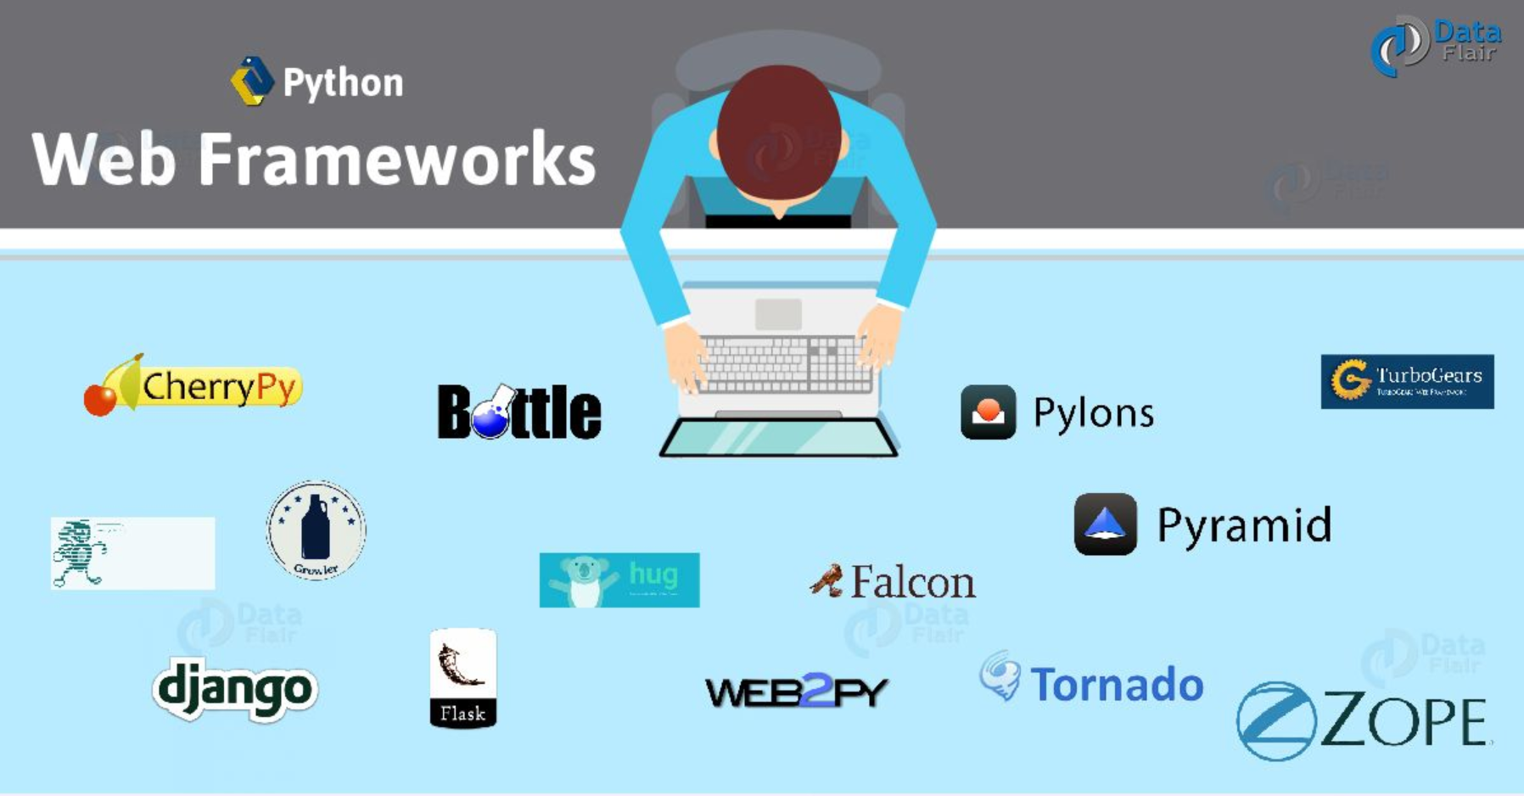
Python For Web Development(Framework)
Django
Web2Py
Flask
Cubic Web…etc…

Slide 8
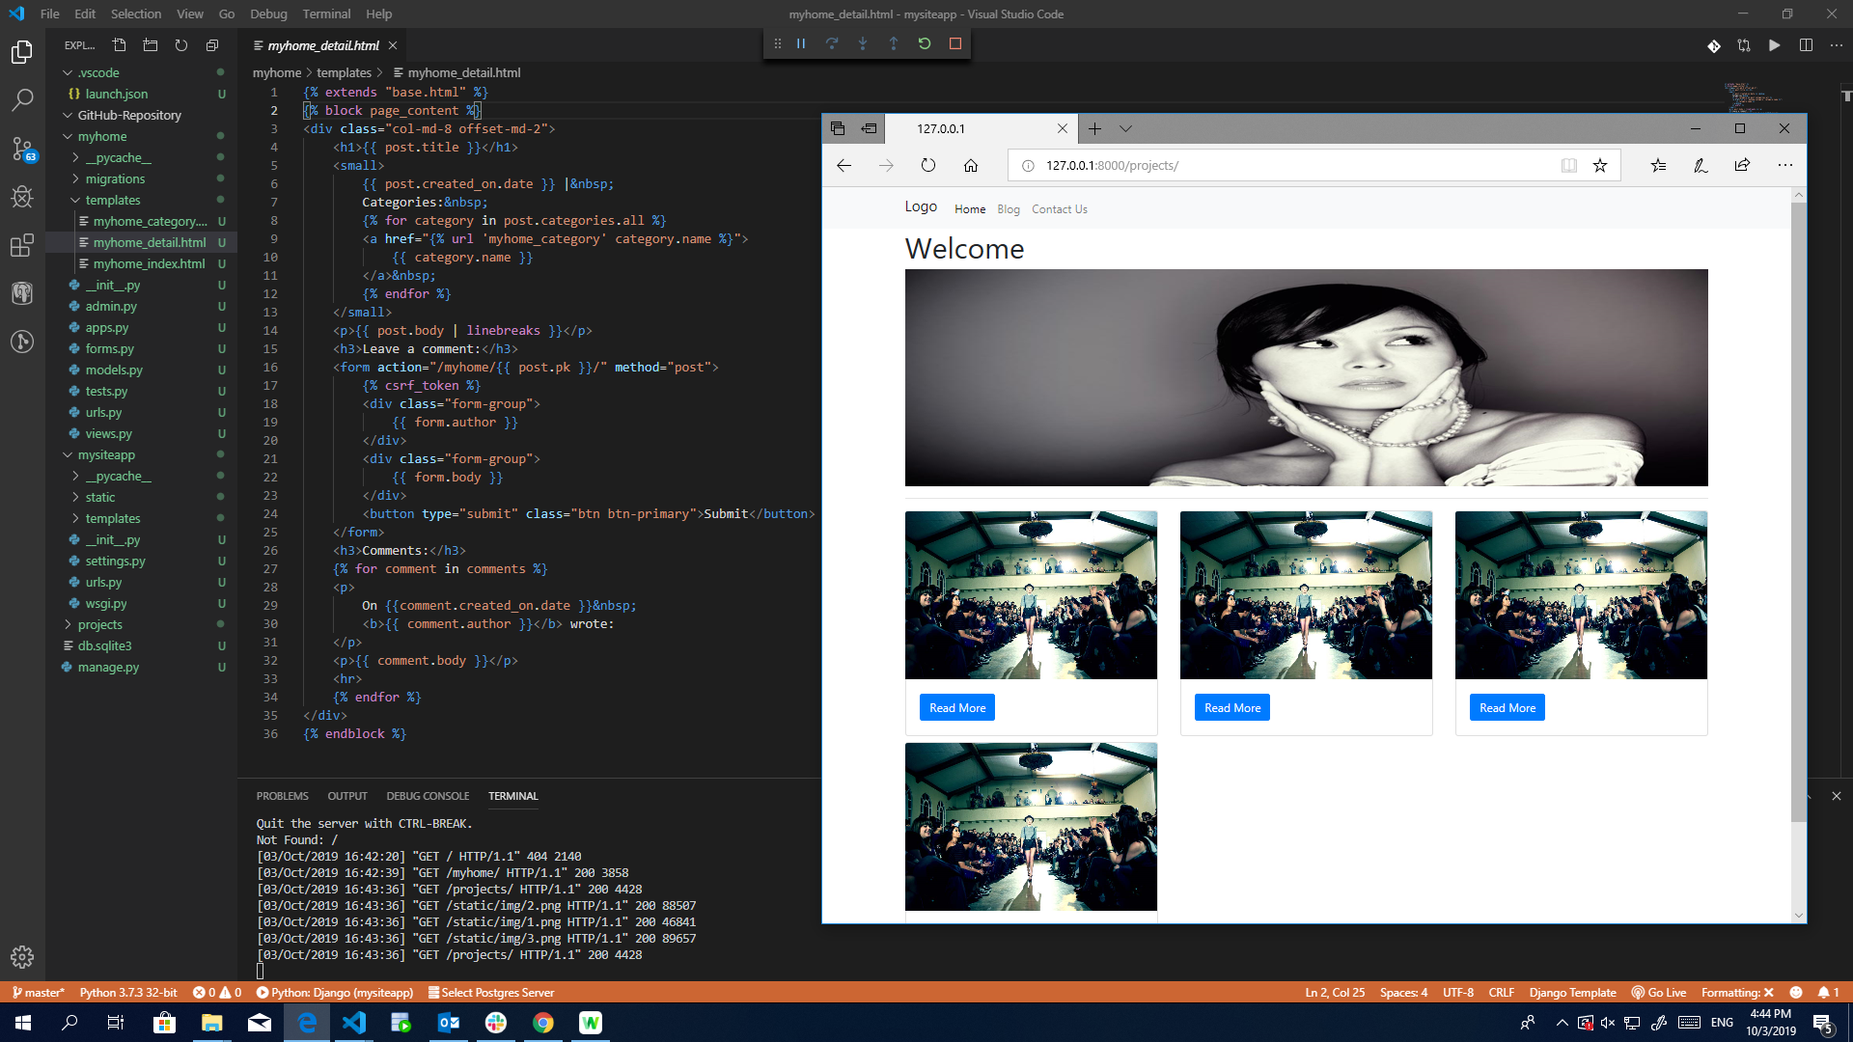
Django Framework

Slide 9
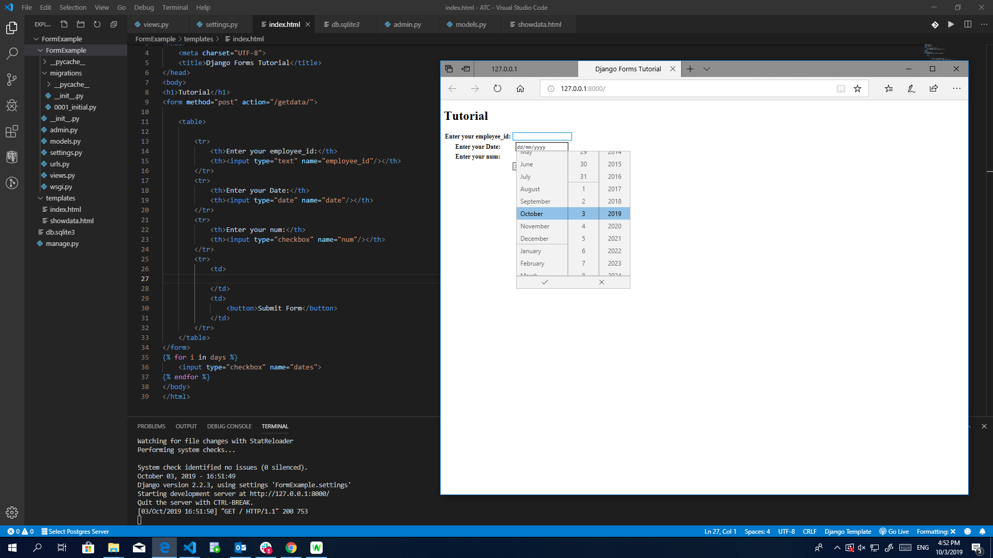
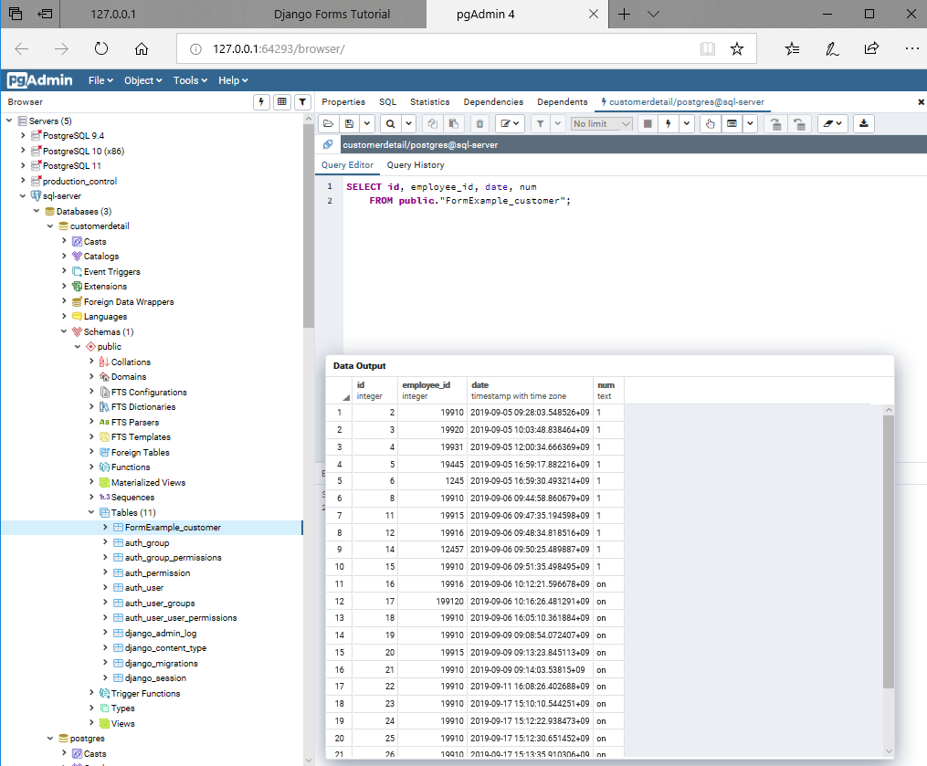
Django+Postgresql

Slide 10
Conclusion
Business Intelligence Tools
Python Data Visualization Libraries
Python Framework
Postgresql
Python Programming languages is not the only best programming language; it is one of the best programming languages.

Slide 11
Thank you..!!
By
ZAR PWINT PHYU

